Slide 1
OFFERING MEMORANDUM
FOR SALE
15000 block of FM 2493 (Old Jacksonville Highway)
Tyler, Texas
The information contained herein is

Slide 2
EXECUTIVE SUMMARY
The fastest growing residential / commercial corridor in East Texas.
TXDOT is in the process of expanding FM 2493 from four to six lanes.
.4 miles to Toll 49
Surrounding Users:
Bruno’s Pizza
Gleaux Carwash
Tyler Tennis & Athletic Club
Texas Bank
Christ Church
Lanes Chapel Methodist Church
Southside Baptist Church
Jack Elementary School
Faulkner Park

Slide 3
PROPERTY INFORMATION
Price: $530,000.00 / $12.12 psf
Acreage: 1.0038 Acres / 43,725.52 sf
Zoning: None
Utilities:
Water: Southern Utilities
Sanitary Sewer: Liberty Utilities
Gas: CenterPoint
Electricity: Deregulated

Slide 4
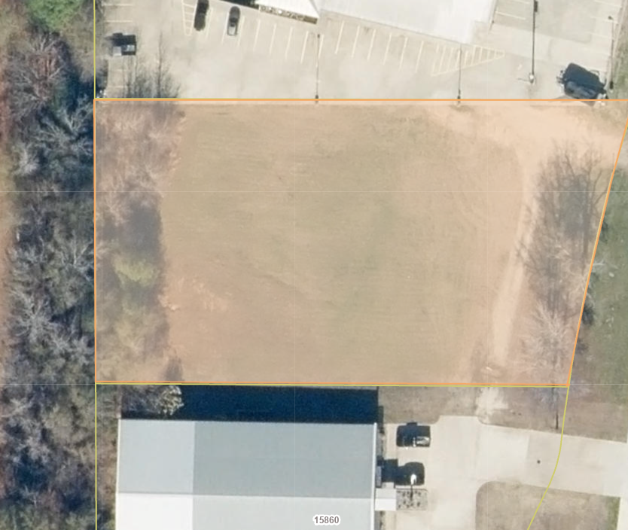
AERIAL (Close In)

Slide 5
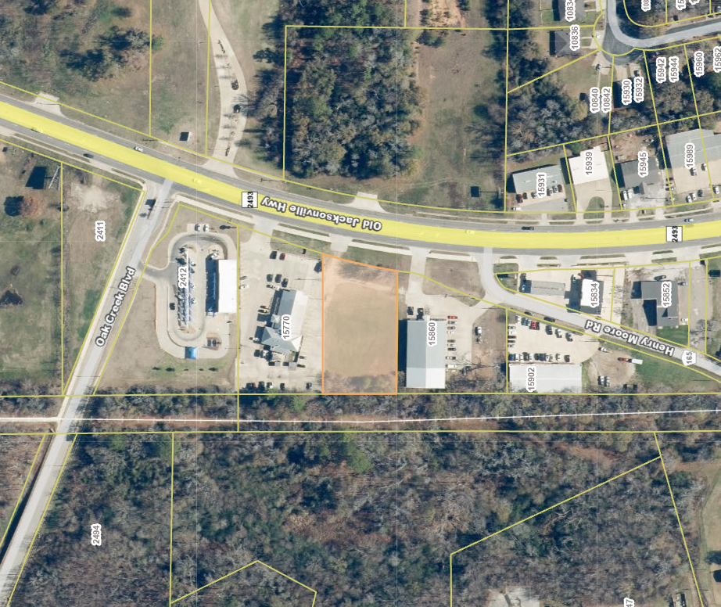
AERIAL (Mid-range)

Slide 6
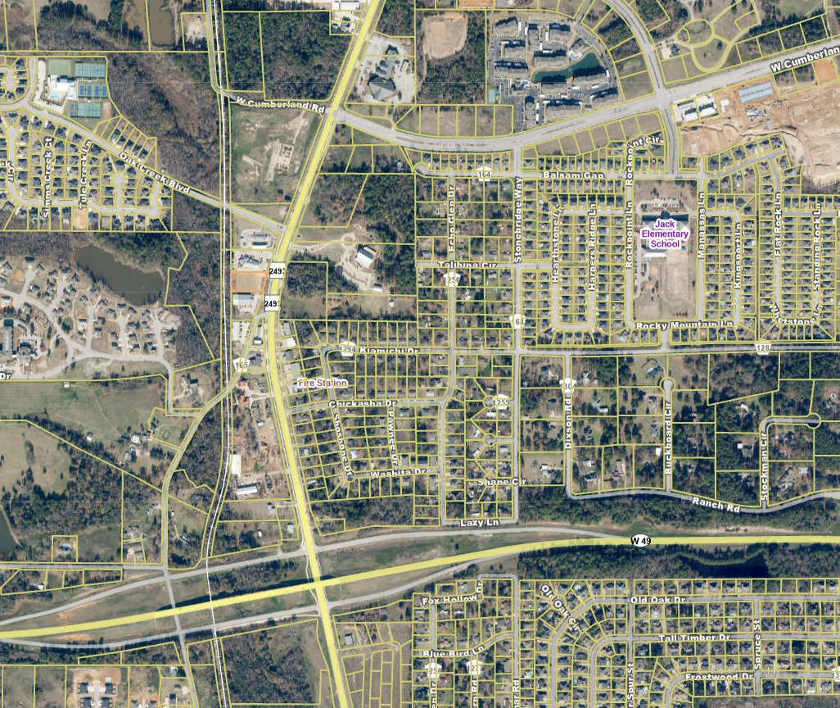
AERIAL (Birds Eye)

Slide 7
DISCLAIMER
Confidentiality & Disclaimer This Offering Memorandum has been prepared solely for the purpose of providing information to prospective purchasers of the property described herein (the “Property”). The information contained in this Memorandum has been obtained from sources believed to be reliable; however, [Brokerage/Owner] makes no warranties or representations as to the accuracy or completeness of the information. All prospective purchasers are strongly advised to conduct their own independent due diligence, including, but not limited to, verification of all property information, financial data, zoning and legal status, and physical condition.
No Warranty or Representation Neither the Owner nor its agents make any representation or warranty, express or implied, as to the accuracy or completeness of the information contained herein, and no legal liability is assumed or shall be implied with respect thereto. Projections, opinions, assumptions, or estimates are for example only and do not represent the current or future performance of the Property.
Confidentiality This Memorandum is a confidential document and is not to be reproduced or distributed to any other person or entity without the express written consent of [Brokerage/Owner]. By receipt of this Memorandum, the recipient agrees that the information is confidential, will be used solely for the purpose of evaluating a potential purchase of the Property, and will not be disclosed to any other party without the prior written consent of [Brokerage/Owner].
Investment Risks All prospective purchasers must take appropriate measures to verify all of the information set forth herein. The Property is being sold on an “as is, where is” basis, and the Owner and its agents make no guarantees or representations regarding the condition of the Property or compliance with applicable laws.

Slide 8

CONTACT INFORMATION
Gary Halbrooks
Venue Properties, Inc.
(903) 530-3374
garyhalbrooks@venueproperties.com

